Slide 1

COA

Slide 2

COA
Up coming Labs (lab 02,03,04)
Labs in next class (follow mandatory requirements)
Lab resources:
MASM 615
Text pad editor
Source codes
Lab manual (hard copy)
Activities on group:
Quiz,Assig 01 solution posted
Result sheet posted
Labs posted

Slide 3

Book reading : Supplementary !!!
Topics covered in this lecture are from these texts.
Assembly Language 6th edition,Kip Irvine
Chapter 4 read 4.2 Flags affected by arithmetic instructions
Read Chapter 3,section 3.4 Defining data
Read Chapter 4,sections
4.3 Data related operations and directives

Slide 4
Lecture 10: Flags

Slide 5
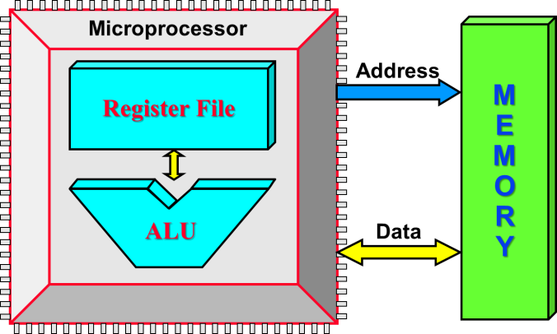
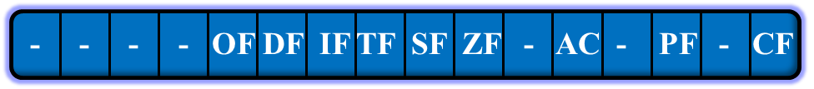
Flags in Register file :
AH
AL
BH
BL
CH
CL
DH
DL
ALU Operations:
ADD
SUB
MUL
DIV
INC
DEC
AND
OR
•
•
SI
DI
BP
SP
IP
CS
DS
ES
SS

Slide 6

Flags
Status Flags
Carry (CF)
Overflow (OF)
Sign (SF)
Zero (ZF)
Auxiliary Carry (AC)
Parity (PF)
Control Flags
Direction, Interrupt, etc.

Slide 7
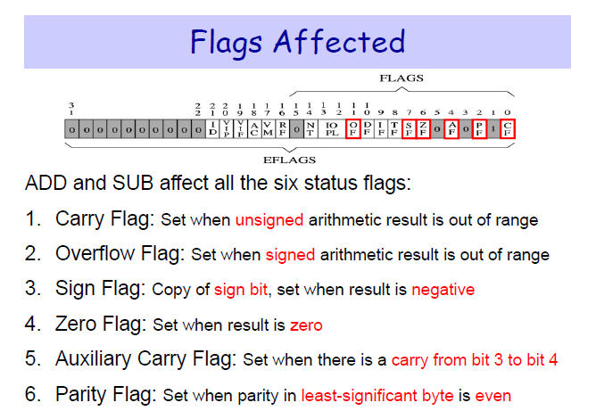

Slide 8
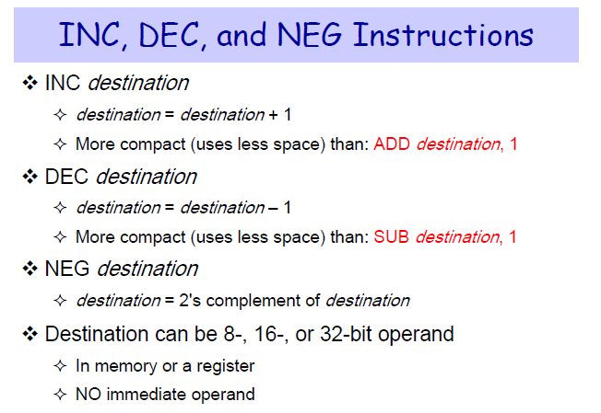
Arithmetic instructions : Assembly !!!

Slide 9
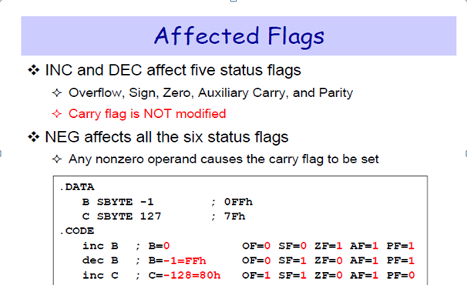
INC & DEC : Assembly

Slide 10
Lab 03:
Flag based !!!

Slide 11

Assembling : Viewing Registers & flags
To display registers and view the status of flags,AL command is …
Call dumpregs

Slide 12
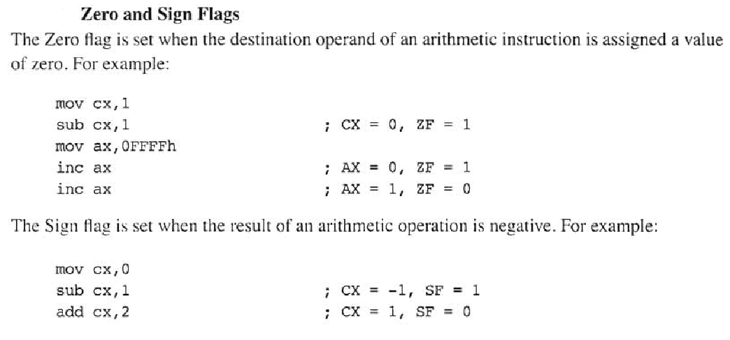
Zero & sign flag : ZF,SF

Slide 13
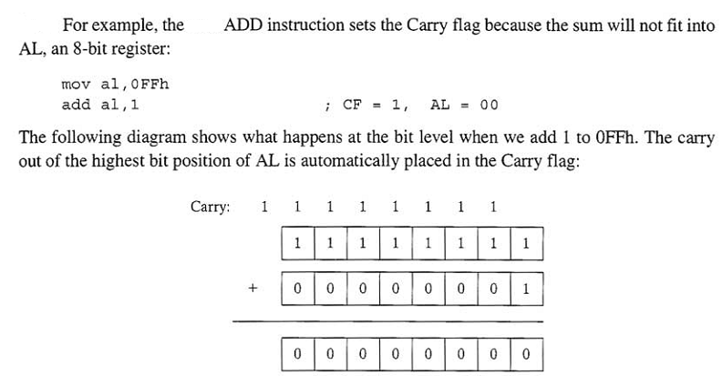
Carry Flag : CF

Slide 14
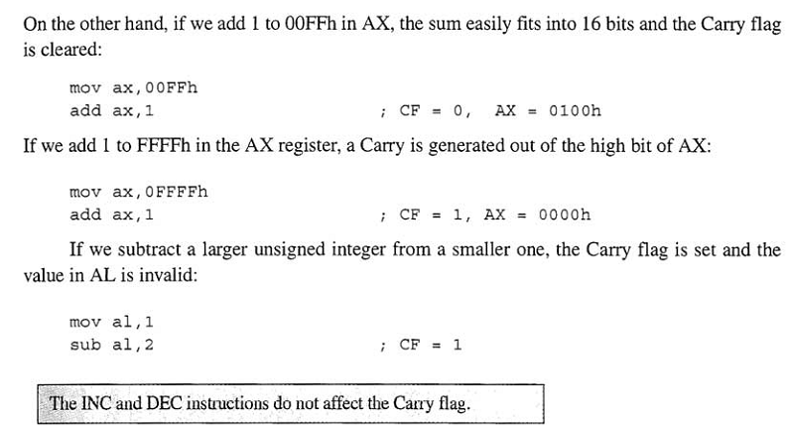
Carry Flag : Caution !!!

Slide 15
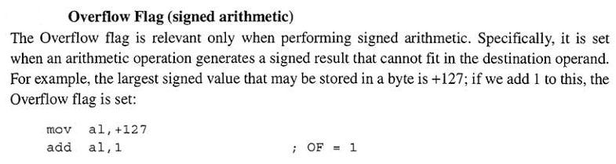
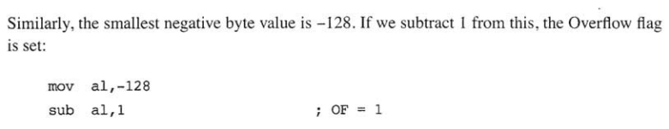
Overflow flag : OF

Slide 16
3.4 Defining Data

Slide 17
Intrinsic Data Types
BYTE 8-bit unsigned integer
SBYTE 8-bit signed integer
WORD 16-bit unsigned integer
SWORD 16-bit signed integer
DWORD 32-bit unsigned integer
SDWORD 32-bit signed integer
FWORD 48-bit integer (Far pointer in protected mode)
QWORD 64-bit integer
TBYTE 80-bit (10-byte) integer
REAL4 32-bit (4-byte) IEEE short real
REAL8 64-bit (8-byte) IEEE long real
REAL10 80-bit (10-byte) IEEE extended real

Slide 18
Data Definition Statement
A data definition statement sets aside storage in memory for a variable
May optionally assign a name (label) to the data
Syntax:
[name] directive initializer [initializer]
value1 BYTE 10
All initializions become binary data in memory
Use ? if no initialization necessary
Example: Var1 BYTE ?

Slide 19
Data Allocation Directives :
value1 BYTE 10 value1 DB 10

Slide 20
Defining BYTE and SBYTE Data
Each of following defines a single byte of storage:
value1 BYTE 'A' ; character constant
value2 BYTE 0 ; smallest unsigned byte
value3 BYTE 255 ; largest unsigned byte
value4 SBYTE -128 ; smallest signed byte
value5 SBYTE +127 ; largest signed byte
value6 BYTE ? ; uninitialized byte
MASM does not prevent you from initializing a BYTE with a negative value, but it is considered poor style
If you declare a SBYTE variable, the Microsoft debugger will automatically display its value in decimal with a leading sign

Slide 21
Defining Byte Arrays : Multiple Initializers
Examples that use multiple initializers:
list1 BYTE 10,20,30,40
list2 BYTE 10,20,30,40
BYTE 50,60,70,80 ;list2 continues
BYTE 81,82,83,84 ;list2 continues
list3 BYTE ?,32,41h,00100010b
list4 BYTE 0Ah,20h,‘A’,22h

Slide 22
Define Word (DW)
Create data having a word attribute
can mix different data representations
can use integer expressions
can contain 16-bit offset of another variable
.data
wordVal dw 1234h,5000h,65535, -24
signed1 db 35 * 4
aString dw "AB"
ptr1 dw offset wordval

Slide 23
Define Doubleword (DD)
Create one or more 32-bit integers
doubleword (dd) attribute
.data
largeVal dd 12345678h
array dd 100 dup(?)
smallVals dd -1,-2,-3,-4,-5

Slide 24
Defining Strings
An array of characters
Usually enclosed in quotation marks
Will often be null-terminated
To continue a single string across multiple lines, end each line with a comma
str1 BYTE "Enter your name",0
str2 BYTE 'Error: halting program',0
str3 BYTE 'A','E','I','O','U'
greeting BYTE "Welcome to the Encryption Demo program "
Message BYTE "created by Kip Irvine.",0

Slide 25
Using the DUP Operator
Use DUP to allocate (create space for) an array or string
Syntax: Counter and argument must be constants or constant expressions
var1 BYTE 20 DUP(0) ; 20 bytes, all equal to zero
var2 BYTE 20 DUP(?) ; 20 bytes, uninitialized
var3 BYTE 4 DUP("STACK"); 20 bytes, ; "STACKSTACKSTACKSTACK"
var4 BYTE 10,3 DUP(0),20 ; mixed form, 5 bytes

Slide 26
Equal-Sign Directive
Syntax:
Name EQU < value >
name = expression
expression is a 32-bit integer (expression or constant)
may be redefined
name is called a symbolic constant
good programming style to use symbols
COUNT = 500
mov al,COUNT
PI EQU <3.146>

Slide 27
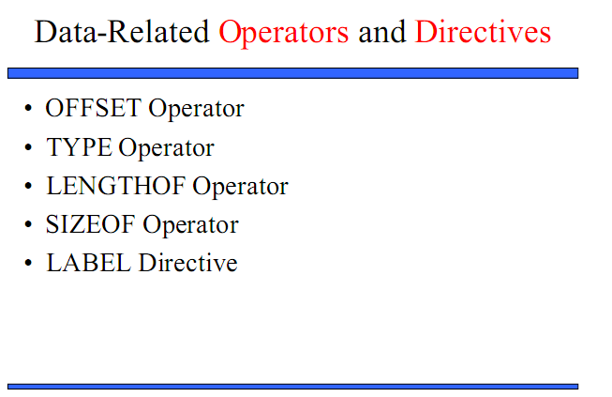

Slide 28
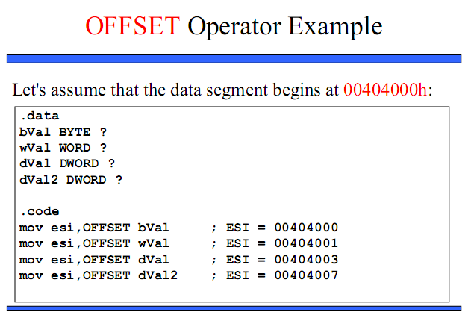

Slide 29
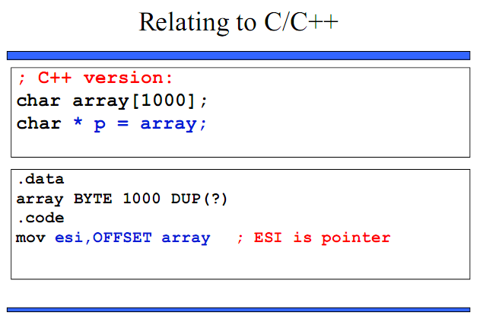

Slide 30
TYPE , LENGTH and SIZE Operators :
TYPE
returns the size, in bytes of a single element of a data label (variable)
LENGTH
returns a count of the number of individual elements in a data label that uses the DUP operator
SIZE
returns the product of TYPE * LENGTH

Slide 31
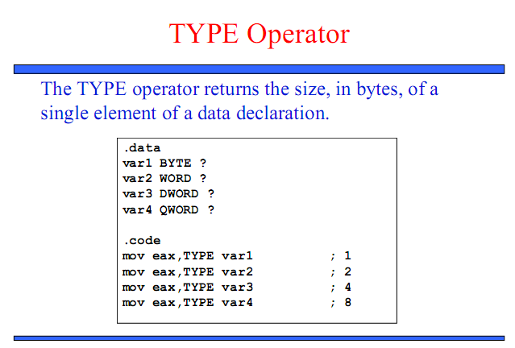

Slide 32
TYPE Operator :
TYPE returns the size attribute for arrays also:
.data
myByte db 1,2,3,4
myWord dw 1000h,2000h,3000h
myDouble dd 12345678h
myQuad dq 1,2,3
.code
mov ax,TYPE myByte ; 1
mov ax,TYPE myWord ; 2
mov ax,TYPE myDouble ; 4
mov ax,TYPE myQuad ; 8

Slide 33
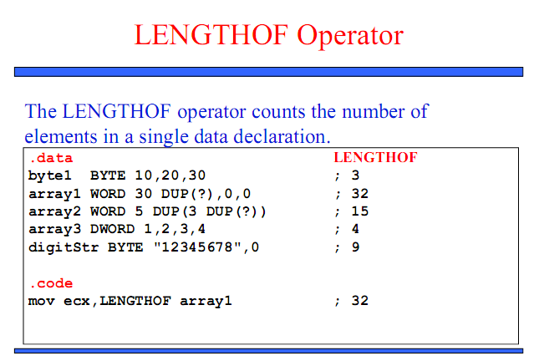

Slide 34
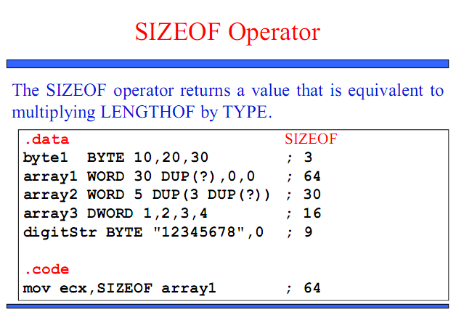

Slide 35

SIZEOF Operator :
Returns TYPE multiplied by LENGTH:
.data
myByte db 20 dup(?)
myWord dw 5 dup(0)
.code
mov ax,SIZEOF myByte
mov ax,SIZEOF myWord
WHAT ARE THE CONTENTS OF AX AFTER LINE1 & LINE2 EXECUTION???
mov ax,SIZEOF myByte AX = 20 (20*1)
mov ax,SIZEOF myWord AX = 10 (5*2)

Slide 36
Indirect Operand :Addressing
.data
aString db "ABCDEFG“
.code
mov bx,offset aString
add bx,5
mov dl,[bx]

Slide 37
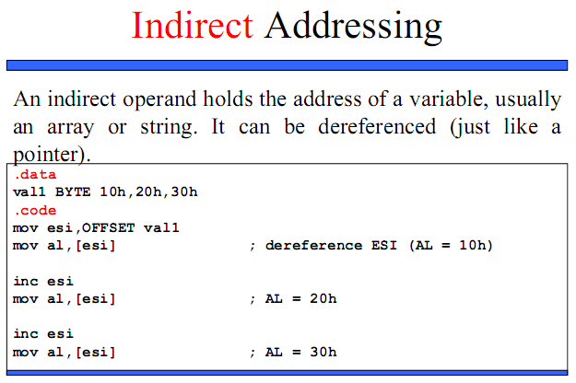

Slide 38
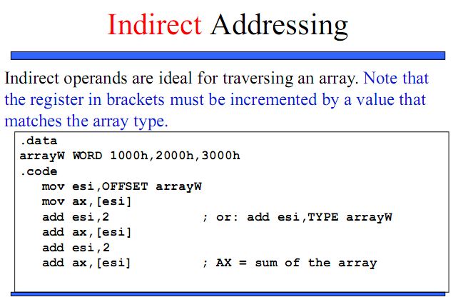

Slide 39
Based-Index Operands
Add the value of a base register to an index register, producing an effective address of 0157:
BX = 0155, SI = 0002
Example...

Slide 40
Base-Index: Example Code
.data
ROWSIZE = 5
array db 10h, 20h, 30h, 40h, 50h
db 60h, 70h, 80h, 90h,0A0h
db 0B0h,0C0h,0D0h,0E0h,0F0h
.code
mov bx,ROWSIZE ; row 1
mov si,2 ; column 2
mov dl,array[bx + si] ; DL = 80h

Slide 41
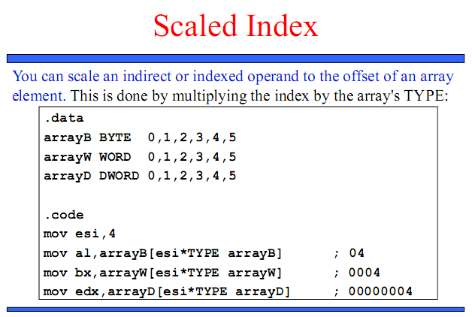

Slide 42
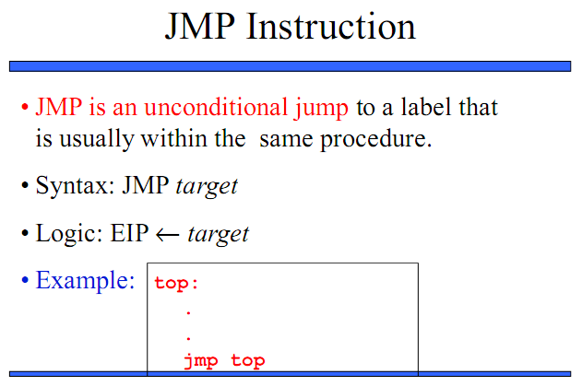

Slide 43
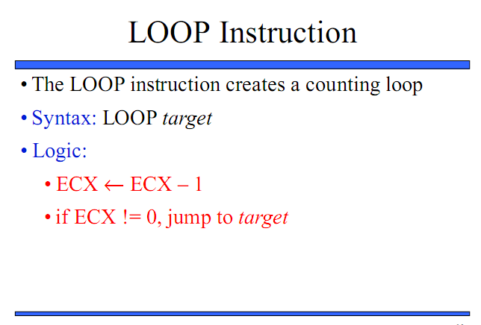

Slide 44
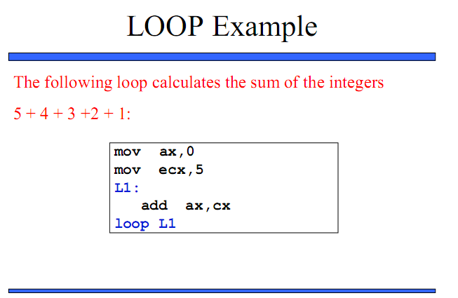

Slide 45
